Slide 1

SCHOOL of COMPUTING DRPARTMENT of COMPUTER SCIENCE & ENGINEERING
COURSE CATEGORY :PROGRAM CORE
COURSE NAME:DATA WAREHOUSING AND DATA MINING
COURSE CODE:1151CS114
FACULTY: Dr. CARMEL MARY BELINDA M J

Slide 2
Course Outcomes
CO Nos. | Course Outcomes | K Level
CO1 | Explain and identify the subject areas for which a data warehouse is to be built. | K2
CO2 | Design Multidimensional data model for data warehouse and analyze the market needs by applying the suitable OLAP operations. | K3
CO3 | Explain the concept of Data mining system and apply the various preprocessing techniques on large dataset. | K2
CO4 | Apply Association rule mining, classification and clustering techniques to discover various mining patterns. | K3
CO5 | Apply clustering techniques in various data mining applications | K3

Slide 3
CO – PO Matrix: NBA
CO Nos. | PO1 | PO2 | PO3 | PO4 | PO5 | PO6 | PO7 | PO8 | PO9 | PO10 | PO11 | PO12 | PSO1 | PSO2 | PSO3
CO1 | 3 | 1 | 2 | 3 |  |  |  |  |  |  |  |  |  | 2
CO2 | 3 | 3 | 2 | 3 |  |  |  | 2 | 2 | 2 |  | 1 |  | 2 | 2
CO3 | 3 | 3 | 3 | 2 |  | 2 |  |  | 1 |  |  | 2 | 2 | 2 | 1
CO4 | 3 | 2 | 3 | 2 |  | 2 |  | 2 | 1 |  |  |  | 3 | 3 | 2
CO5 | 3 | 1 | 3 | 1 | 2 | 2 |  | 2 |  |  |  | 2 | 3 | 3 | 2

Slide 4
CO – SO Matrix: EAC
CO Nos. | SO1 | SO2 | SO3 | SO4 | SO5 | SO6 | SO7
CO1 | 3
CO2 |  | 2
CO3 | 3 |  |  |  |  | 3
CO4 | 3 | 3 |  |  |  | 3
CO5 | 3 | 3 |  |  |  | 3 | 2

Slide 5
CO – SO Matrix: CAC
CO Nos. | SO1 | SO2 | SO3 | SO4 | SO5 | SO6
CO1 | 3 |  |  |  |  | 3
CO2 |  | 2 |  |  |  | 3
CO3 | 3 |  |  |  |  | 3
CO4 | 3 | 3 |  |  |  | 3
CO5 | 3 | 3 |  |  |  | 3

Slide 6
SYLLABUS
Unit I Data Warehousing L-10
Introduction to Data warehousing – Evolution of Decision Support systems – Modeling a Data Warehouse – Granularity in the Data Warehouse - Building a Data Warehouse – Data Warehouse Components –Data Warehouse Architecture - Metadata.
Unit II Business Analysis L-9
Mapping the Data Warehouse to a Multiprocessor Architecture – DBMS Schemas for Decision Support – Data Extraction, Cleanup, and Transformation Tools –. Reporting and Query tools and Applications –Online Analytical Processing (OLAP) – Need – Multidimensional Data Model – OLAP Guidelines – Multidimensional versus Multi relational OLAP – Categorization of OLAP Tools.

Slide 7
SYLLABUS
Unit III Data Mining L-8
Introduction to Data mining and Knowledge Discovery – Data – Databases – Data Mining Functionalities – Steps in Data Mining Process, Architecture of Typical Data Mining systems – Classification of Data Mining Systems – Data Mining Task Primitives – Overview of Data mining Techniques – Issues –Data Preprocessing.
Unit IV Association Rule Mining and Classification L-10
Mining Association Rules in Large Databases – Mining Various Kinds of Association Rules – Correlation Analysis –Constraint Based Association Mining – Classification and Prediction - Basic Concepts - Decision Tree Induction - Bayesian Classification –Classification by Back propagation – Support Vector Machines – Associative Classification – Lazy Learners – Other Classification Methods – Prediction.

Slide 8
SYLLABUS
Unit V Clustering, Applications and Trends in Data Minin L-8
Cluster Analysis - Types of Data – Categorization of Major Clustering Methods - K- means – Partitioning Methods – Hierarchical Methods - Outlier Analysis – Data Mining Applications – Social Impacts of Data Mining – Mining WWW - Mining Text Database – Mining Spatial Databases - Case Studies (Simulation Tool).

Slide 9
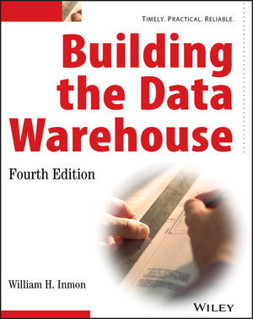
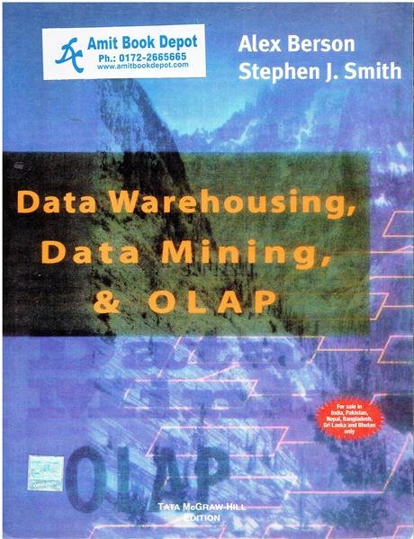

Learning Resource
Text Books
1. W.H. Inmon, “Building the Data Warehouse”, John Wiley & Sons, Inc, 4th Edition, 2005.
2. Alex Berson and Stephen J. Smith, “Data Warehousing, Data Mining & OLAP”, Tata
McGraw – Hill Edition, Tenth Reprint 2007.
3. Jiawei Han and Micheline Kamber, MALEHosteller03.08.2020“Data Mining Concepts and Techniques”, Third Edition, Elsevier, 2012.

Slide 10
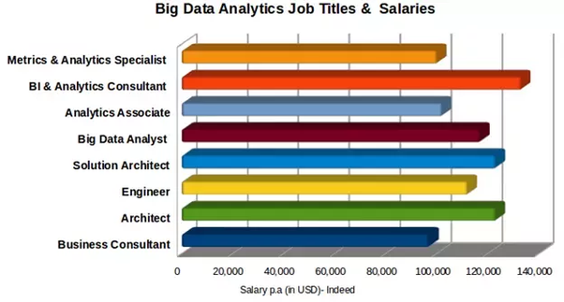
Job Opportunity

Slide 11
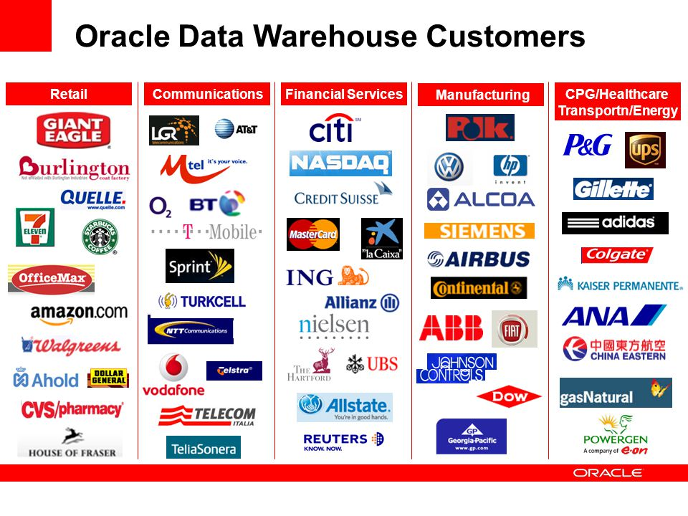
Job Opportunities

Slide 12
Unit I Data Warehousing
Topics Covered:
Introduction to Data warehousing
Evolution of Decision Support systems
Modeling a Data Warehouse
Granularity in the Data Warehouse
Building a Data Warehouse
Data Warehouse Components
Data Warehouse Architecture
Metadata

Slide 13


Heterogeneous Information Sources
“Heterogeneities are everywhere”
Personal
Databases
World
Wide
Web
Scientific Databases
Digital Libraries
Different interfaces
Different data representations
Duplicate and inconsistent information

Slide 14
Goal: Unified Access to Data
Integration System
World
Wide
Web
Personal
Databases
Digital Libraries
Scientific Databases
Collects and combines information
Provides integrated view, uniform user interface
Supports sharing

Slide 15
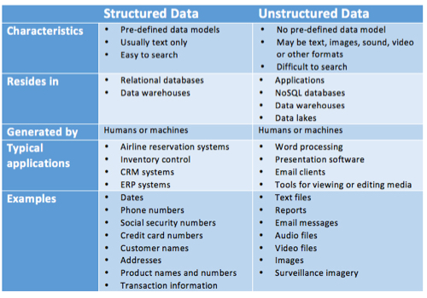
Difference between Structured and Unstructured data

Slide 16
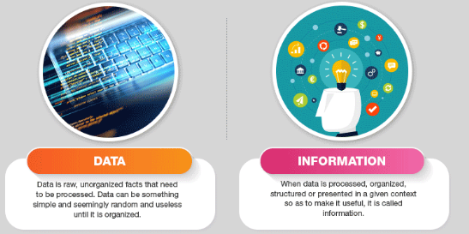
What is data and information

Slide 17

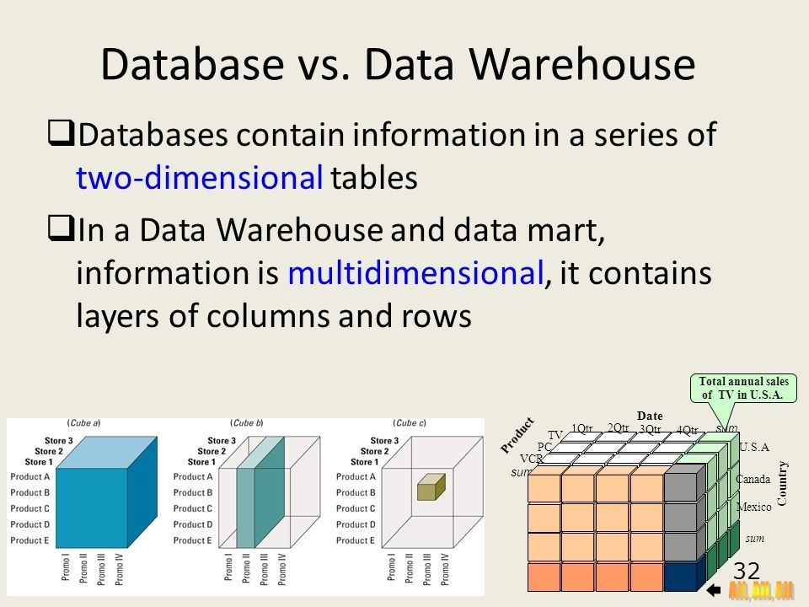

Slide 18
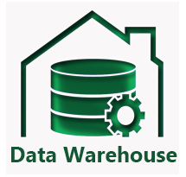
Introduction to Data warehousing
What is a Data Warehouse?
A Data Warehouse (DW) is a relational database that is designed for query and analysis rather than transaction processing.
It includes historical data derived from transaction data from single and multiple sources.

Slide 19
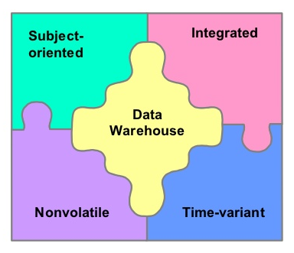
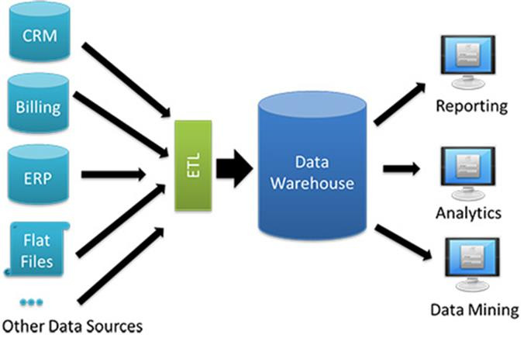
What is Data Warehouse?
“A data warehouse is a subject-oriented, integrated, time-variant, and nonvolatile collection of data in support of management’s decision-making process.”—W. H. Inmon

Slide 20
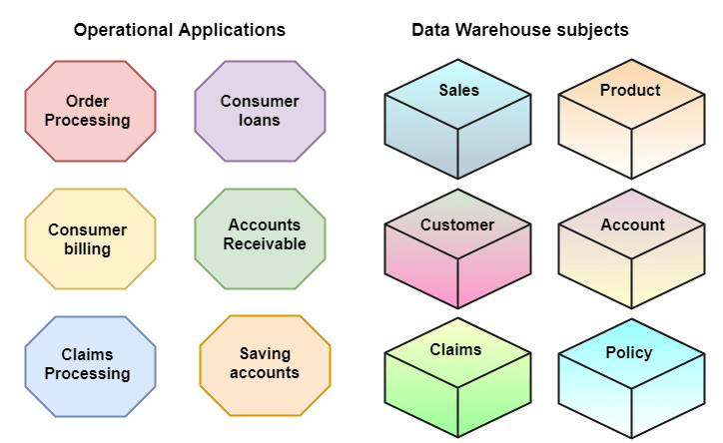
Subject-Oriented
A data warehouse target on the modeling and analysis of data for decision-makers.

Slide 21
Integrated
A data warehouse integrates various heterogeneous data sources like RDBMS, flat files, and online transaction records.
It requires performing data cleaning and integration during data warehousing to ensure consistency in naming conventions, attributes types, etc., among different data sources.

Slide 22
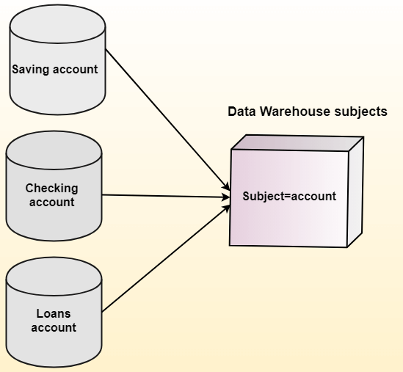
Integrated

Slide 23

Time-Variant
Historical information is kept in a data warehouse.

Slide 24
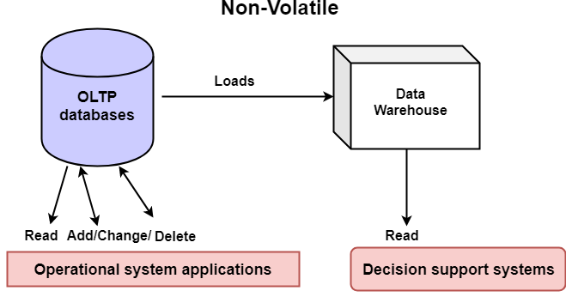
Non-Volatile
Non-Volatile defines that once entered into the warehouse, and data should not change.

Slide 25
What is Data Warehousing?
A process of transforming data into information and making it available to users in a timely enough manner to make a difference
Information
Data

Slide 26


Goals of Data Warehousing
To help reporting as well as analysis
Maintain the organization's historical information
Be the foundation for decision making.
Data Warehouses are designed to perform well enormous amounts of data.
The structure of data warehouses is more accessible for end-users to navigate, understand, and query.

Slide 27
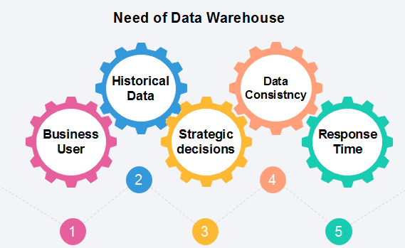
Need for Data Warehouse
Data Warehouse is needed for the following reasons:

Slide 28
Business User: Business users require a data warehouse to view summarized data from the past.
Store historical data: Data Warehouse is required to store the time variable data from the past. This input is made to be used for various purposes.
Make strategic decisions: Some strategies may be depending upon the data in the data warehouse. So, data warehouse contributes to making strategic decisions.
For data consistency and quality: Bringing the data from different sources at a commonplace, the user can effectively undertake to bring the uniformity and consistency in data.
High response time: Data warehouse has to be ready for somewhat unexpected loads and types of queries, which demands a significant degree of flexibility and quick response time.

Slide 29
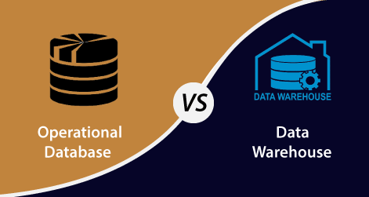
Difference between Operational Database and Data Warehouse

Slide 30
Difference between Operational Database and Data Warehouse
Operational Database | Data Warehouse
Operational systems are designed to support high-volume transaction processing. | Data warehousing systems are typically designed to support high-volume analytical processing (i.e., OLAP).
Operational systems are usually concerned with current data. | Data warehousing systems are usually concerned with historical data.
Data within operational systems are mainly updated regularly according to need. | Non-volatile, new data may be added regularly. Once Added rarely changed.
It is designed for real-time business dealing and processes. | It is designed for analysis of business measures by subject area, categories, and attributes.
Operational systems are widely process-oriented. | Data warehousing systems are widely subject-oriented

Slide 31
Difference between Operational Database and Data Warehouse
Operational Database | Data Warehouse
Operational systems are usually optimized to perform fast inserts and updates of associatively small volumes of data. | Data warehousing systems are usually optimized to perform fast retrievals of relatively high volumes of data.
Less Number of data accessed. | Large Number of data accessed.
Relational databases are created for on-line transactional Processing (OLTP) | Data Warehouse designed for on-line Analytical Processing (OLAP)

Slide 32
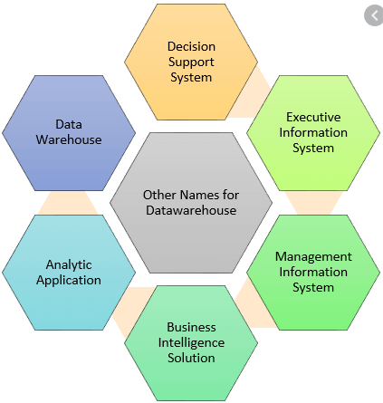
Other names of Data Warehouse

Slide 33
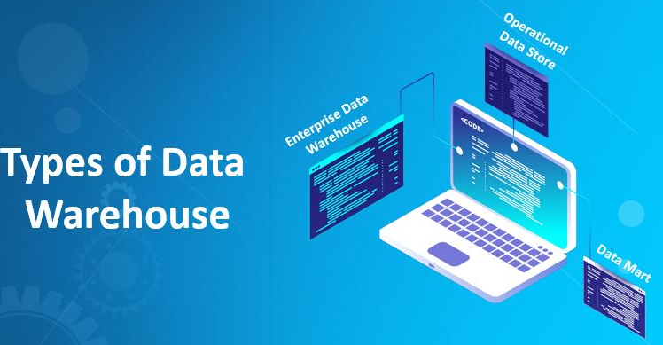
Introduction to Data Warehousing Types
The three main types of Data Warehouses are:
Enterprise Data Warehouse
Operational Data Store
Data Mart

Slide 34
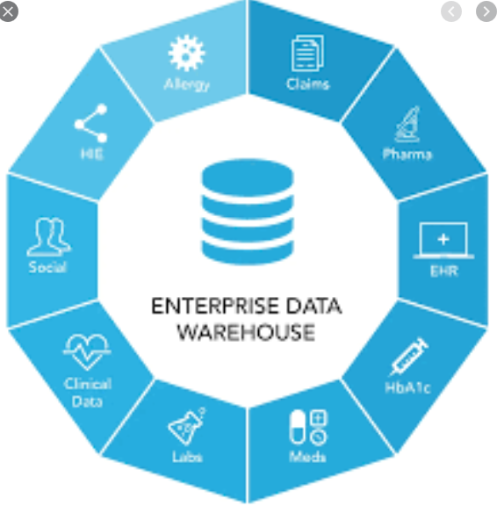
Enterprise Data Warehouse
It is a centralized warehouse, which provides decision support service across the enterprise.
It organize and represent data.
It also provides the ability to classify data according to the subject and give access according to those divisions.

Slide 35
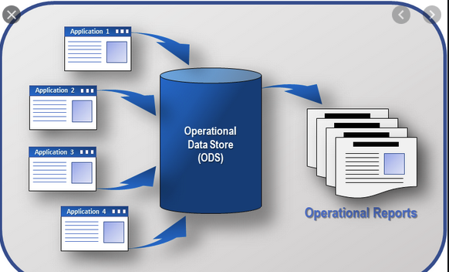
Operational Data Store
It is also called ODS, is data store required when neither Data warehouse nor OLTP systems support organizations reporting needs.
it is widely preferred for routine activities like storing records of the Employees.

Slide 36
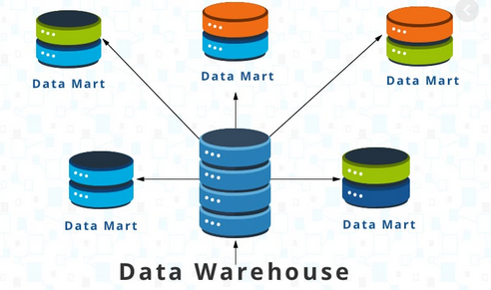
Data Mart:
A Data Mart is a subset of the data warehouse.
It specially designed for specific segments like sales, finance, sales, or finance.
In an independent data mart, data can collect directly from sources.

Slide 37
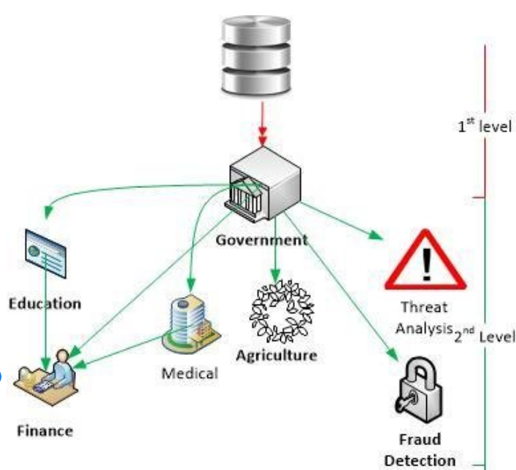
Data Warehouse Applications
Financial services
Banking services
Consumer goods
Retail sectors
Controlled manufacturing

Slide 38
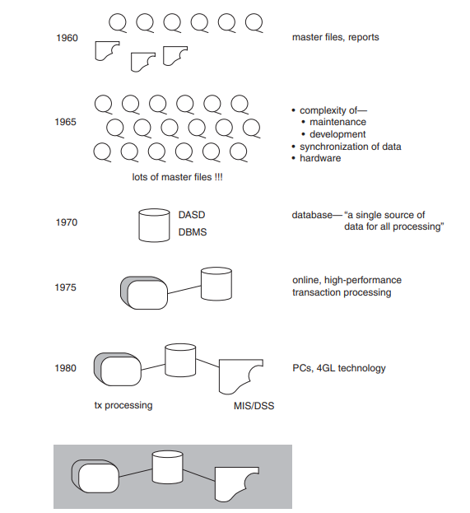
Evolution of Decision Support System
The decision support system (DSS) processing developed out of a long and complex evolution of information technology.

Slide 39
In the early 1960s, the world of computation consisted of creating individual applications that were run using master files.
The applications featured reports and programs, usually built in COBOL.
Punched cards were common.
The master files were housed on magnetic tape, which were good for storing a large volume of data cheaply, but the drawback was that they had to be accessed sequentially.

Slide 40
The mid-1960s, the growth of master files and magnetic tape exploded with that growth came huge amounts of redundant data.
By 1970, the day of a new technology for the storage and access of data had dawned. The 1970s saw the advent of disk storage, or direct access storage device (DASD).
Disk storage was fundamentally different from magnetic tape storage in that data could be accessed directly on DASD.
The mid-1970s, online transaction processing (OLTP) made even faster access to data possible, opening whole new vistas for business and processing.

Slide 41
By the 1980s, more new technologies, such as PCs and fourth-generation languages (4GLs), began to surface.
The end user began to directly controlling data and systems, a role previously reserved for the data processor.
After the advent of massive OLTP systems, an innocuous program for “extract” processing began to appear

Slide 42
The Spider Web
A “spider web” of extract processing began to form. First, there were extracts; then there were extracts of extracts; then extracts of extracts of extracts; and so forth
A large company can perform 45000 extracts per day

Slide 43
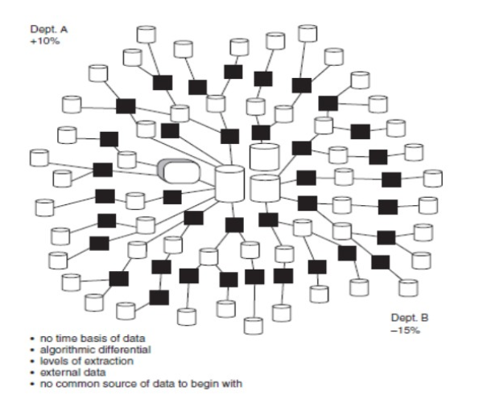
The Spider Web

Slide 44
Problems with the Naturally Evolving Architecture
The naturally evolving architecture presents many challenges, such as:
Data credibility
Productivity
Inability to transform data into information

Slide 45
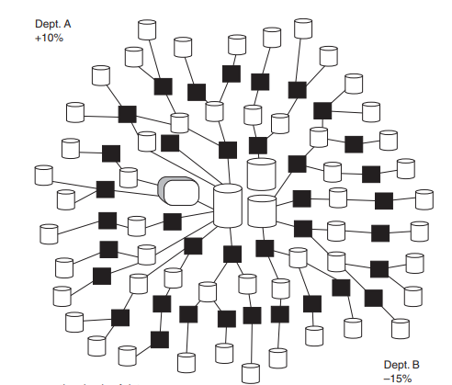
Lack of Data Credibility
Two departments are delivering a report to management—one department claims that activity is down 15 percent, the other says that activity is up 10 percent
Not only are the two departments not in sync with each other, they are off by very large margins

Slide 46
There are five reasons for Lack of data credibility:
No time basis of data
The algorithmic differential of data
The levels of extraction
The problem of external data
No common source of data from the beginning

Slide 47
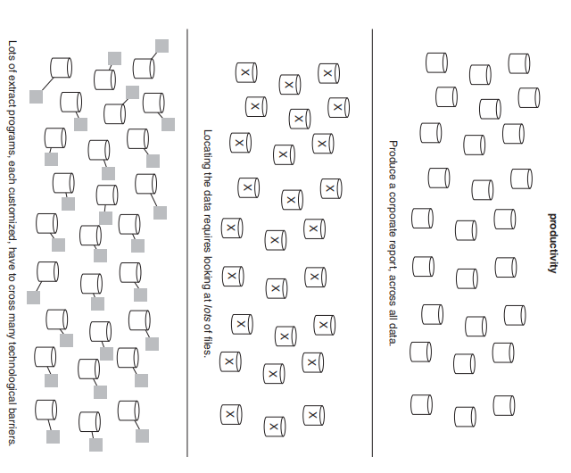
Productivity
Productivity is also major problem , especially when there is a need to analyze data across the organization.

Slide 48
Management wants to produce a corporate report, using the many files and collections of data that have accumulated over the years.
The designer assigned the task decides that three things must be done to produce the corporate report:
Locate and analyze the data for the report.
Compile the data for the report.
Get programmer/analyst resources to accomplish these two tasks.

Slide 49
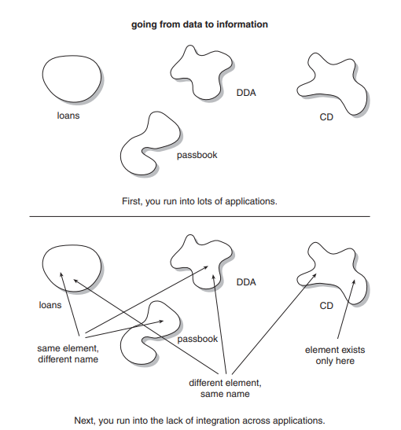
From Data to Information
As if productivity and credibility were not problems enough, there is another major fault of the naturally evolving architecture, the inability to go from data to information.

Slide 50
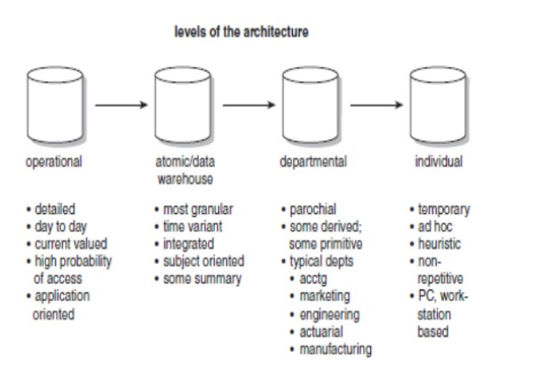
Levels of Architecture

Slide 51
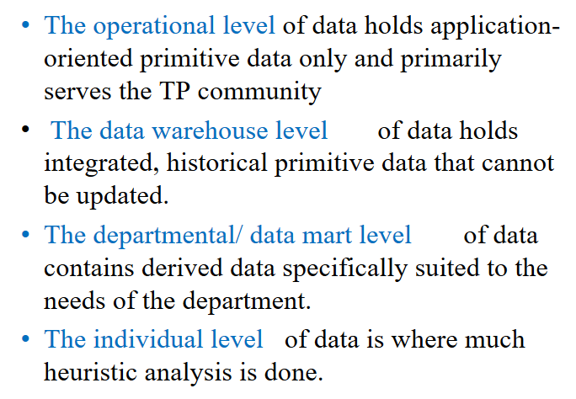
Levels of Architecture

Slide 52
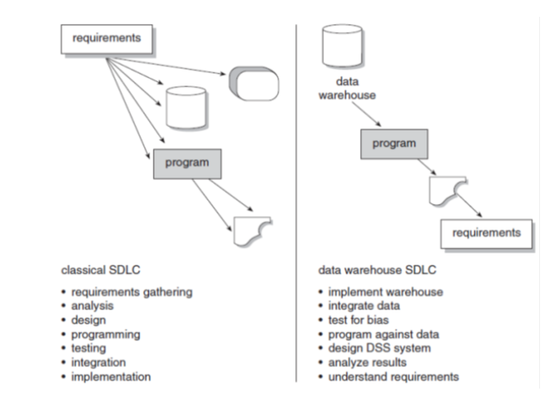
Development Lifecycle

Slide 53
Modeling a Data Warehouse
Data warehouse modeling is the process of designing the schemas of the detailed and summarized information of the data warehouse.
The goal of data warehouse modeling is to develop a schema describing the reality, or at least a part of the fact, which the data warehouse is needed to support.

Slide 54
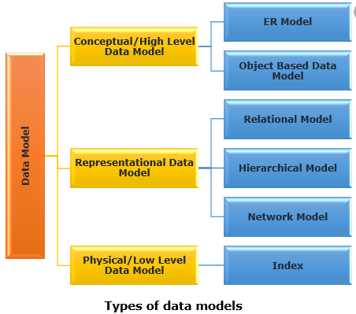
Types of Data Model
Conceptual Data Model
Logical Data Model
Physical Data Model

Slide 55
Conceptual Data Model
A conceptual data model recognizes the highest-level relationships between the different entities.
Characteristics of the conceptual data model
It contains the essential entities and the relationships among them.
No attribute is specified.
No primary key is specified.

Slide 56
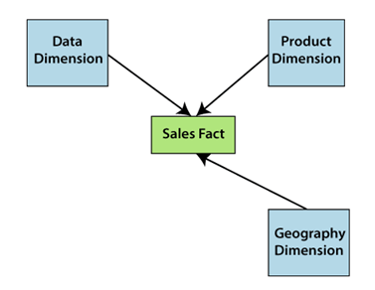
Example

Slide 57
Logical Data Model
A logical data model defines the information in as much structure as possible, without observing how they will be physically achieved in the database.
Features of a logical data model
It involves all entities and relationships among them.
All attributes for each entity are specified.
The primary key for each entity is stated.
Referential Integrity is specified (FK Relation).
The phase for designing the logical data model which are as follows:
Specify primary keys for all entities.
List the relationships between different entities.
List all attributes for each entity.
Normalization.
No data types are listed

Slide 58
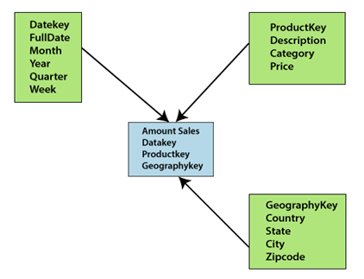
Example

Slide 59
Physical Data Model
Physical data model describes how the model will be presented in the database.
A physical database model demonstrates all table structures, column names, data types, constraints, primary key, foreign key, and relationships between tables.
Characteristics of a physical data model
Specification all tables and columns.
Foreign keys are used to recognize relationships between tables.
The steps for physical data model design which are as follows:
Convert entities to tables.
Convert relationships to foreign keys.
Convert attributes to columns.

Slide 60
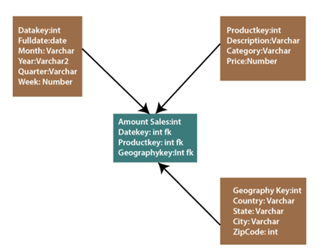
Example

Slide 61
Granularity in the Data Warehouse
Granularity is also important to the warehouse architect because it affects all of the environments that depend on the warehouse for data.
Granularity affects how efficiently data can be shipped to the different environments determines the types of analysis that can be done.
The primary issue of granularity is that of getting it at the right level. The level of granularity needs to be neither too high or too low

Slide 62
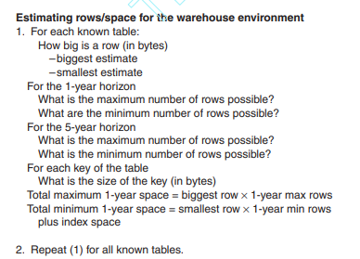
Raw Estimates
The starting point for determining the appropriate level of granularity is to do a raw estimate of the number of rows of data and the DASD (direct access storage device) that will be in the data warehouse.

Slide 63
The first step is to identify all the tables to be built. As a rule of thumb, there will be one or two really large tables and many smaller supporting tables.
Next, estimate the size of the row in each table. It is likely that the exact size will not be known.
A lower-bound estimate and an upper-bound estimate are sufficient.
Next, on the one-year horizon, estimate the maximum and minimum number of rows in the table.
Once the estimate of number of units of data in the data warehouse is made (using a high and a low projection), repeat the process, but this time for the five-year horizon.

Slide 64
After the raw data projections are made, the index data space projections are calculated.
For each table, for each key in the table or element of data that will be searched directly, identify the length of the key or element of data and determine whether the key will exist for each entry in the primary table.

Slide 65
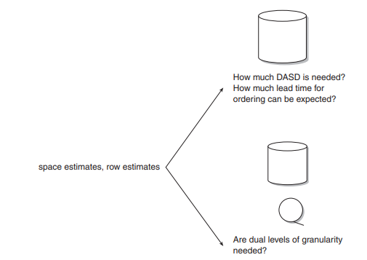
Input to the Planning Process
The estimate of rows and DASD then serves as input to the planning process
When the estimates are made, accuracy is desirable to the order of magnitude.

Slide 66
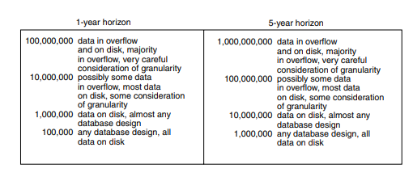
Data in Overflow
Once the raw estimate as to the size of the data warehouse is made, the next step is to compare the total number of rows in the warehouse environment to the charts .

Slide 67
Overflow Storage
Data grows large a natural subdivision of data occurs between actively used data and inactively used data
Inactive data is sometimes called dormant data.
The actively used portion of the data warehouse remains on disk storage, while the inactive portion of the data in the data warehouse is placed on alternative storage or near-line storage.

Slide 68
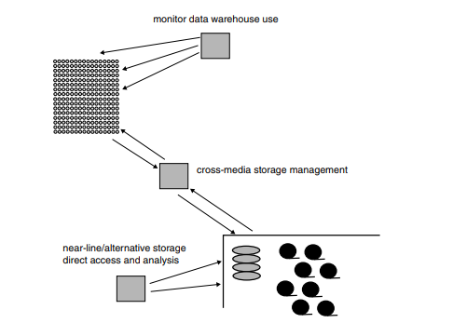
Overflow Storage

Slide 69
Overflow Storage
Data monitor is needed to determine the usage of data.
The data monitor tells where to place data.
The movement between disk storage and near-line storage is controlled by means of software called a cross media storage manager.
The data in alternate storage/near-line storage can be accessed directly by means of software that has the intelligence to know where data is located in near-line storage.

Slide 70
Overflow Storage
The two pieces of software are needed for the overflow environment to operate properly a cross-media storage manager and an activity monitor.
The cross-media storage manager manages the traffic of data going to and from the disk storage environment to the alternate storage environment.

Slide 71
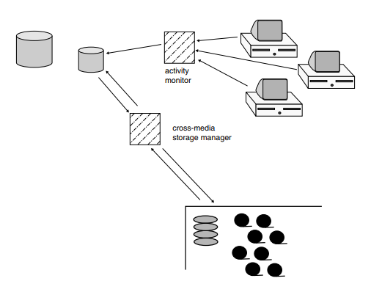
The activity monitor, determines what data is and is not being accessed.
The activity monitor supplies the intelligence to determine where data is to be placed—on disk storage or on alternate storage.

Slide 72
Levels of Granularity
The process which needs to be followed is
Build a small subset quickly based on the feedback
Prototyping
Looking what other people have done
Working with experienced user
Looking at what the organization has now
Having sessions with the simulated output.

Slide 73
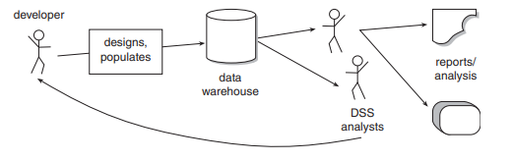

Slide 74
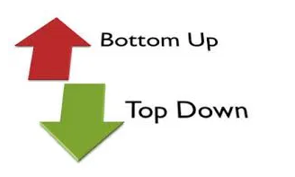
Building a Data Warehouse
Data warehouse design is the key technique.
Two type of data warehouse design approaches
Bottom Up Design
Top Down Design

Slide 75
Bottom Up Design
Kimball’s bottom up approach
A data mart provide a thin view into the organisational data and addresses a single business area.
These data marts are then integrated into larger data warehouse to build a complete data warehouse.
The integration of data marts is implemented using Kimball’s data warehousing architecture which is also known as data warehouse bus (BUS).
In this architecture, a dimension is shared between facts in two or more data marts.

Slide 76
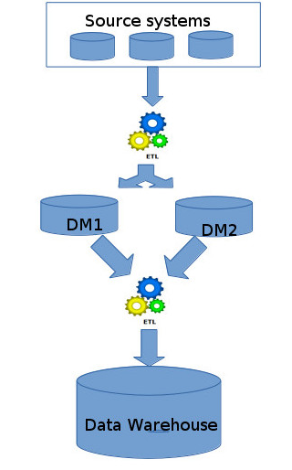
Bottom Up Design

Slide 77
Advantages Of Bottom Up Design
The model contains consistent data marts and these data marts can be delivered quickly.
The data marts are created first to provide reporting capability
It is easier to extend the data warehouse as it can easily accommodate new business units.
It is just creating new data marts and then integrating with other data marts.
This Approach take less time.

Slide 78
Disadvantages Of Bottom Up Design
The positions of the data warehouse and the data marts are reversed in the bottom-up approach design.
It is difficult to maintain and often redundant and subject to revisions

Slide 79
Top Down Design
Inmon’s Top Down Approach
data warehouse is built first.
Inmon defines a data warehouse as a centralized repository for the entire enterprise.
Dimensional data marts are created only after the complete data warehouse has been created.

Slide 80
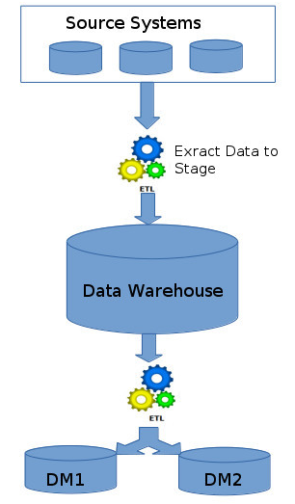
Top Down Design

Slide 81
Advantages of Top Down Design
It is easier to maintain Top Down Design
Provides consistent dimensional views of data across data marts, as all data marts are loaded from the data warehouse.
Creating a new data mart from the data warehouse is very easy.
Initial cost is high but subsequent project development cost is lower

Slide 82
Disadvantages of Top Down Design
It represents a very large project and the cost of implementing the project is significant.
It is time consuming and more time required for initial set up
Highly skilled people required for set up

Slide 83
Difference between Top-Down Design Approach and Bottom-Up Design
Top-Down Design Approach | Bottom-Up Design Approach
Breaks the vast problem into smaller subproblems. | Solves the essential low-level problem and integrates them into a higher one.
Inherently architected- not a union of several data marts. | Inherently incremental; can schedule essential data marts first.
Single, central storage of information about the content. | Departmental information stored.
Centralized rules and control. | Departmental rules and control.
It includes redundant information. | Redundancy can be removed.
It may see quick results if implemented with repetitions. | Less risk of failure, favorable return on investment, and proof of techniques.

Slide 84
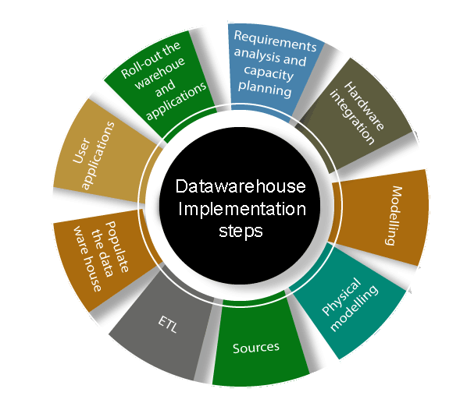
Data Warehouse Implementation

Slide 85
Data Warehouse Implementation
Requirements analysis and capacity planning
The first process in data warehousing involves defining enterprise needs, defining architectures, carrying out capacity planning, and selecting the hardware and software tools.
Hardware integration
Once the hardware and software has been selected, they require to be put by integrating the servers, the storage methods, and the user software tools.

Slide 86
Data Warehouse Implementation
Modeling:
Modelling is a significant stage that involves designing the warehouse schema and views.
Physical modeling
This contains designing the physical data warehouse organization, data placement, data partitioning, deciding on access techniques, and indexing.

Slide 87
Data Warehouse Implementation
Sources
The information for the data warehouse is likely to come from several data sources.
ETL
The data from the source system will require to go through an ETL phase. The process of designing and implementing the ETL phase may contain defining a suitable ETL tool vendors and purchasing and implementing the tools.

Slide 88
Data Warehouse Implementation
Populate the data warehouses:
Once the ETL tools have been agreed upon, testing the tools will be needed, perhaps using a staging area. Once everything is working adequately, the ETL tools may be used in populating the warehouses given the schema and view definition.
User applications:
This step contains designing and implementing applications required by the end-users.
Roll-out the warehouses and applications:
Once the data warehouse has been populated and the end-client applications tested, the warehouse system and the operations may be rolled out for the user's community to use.

Slide 89
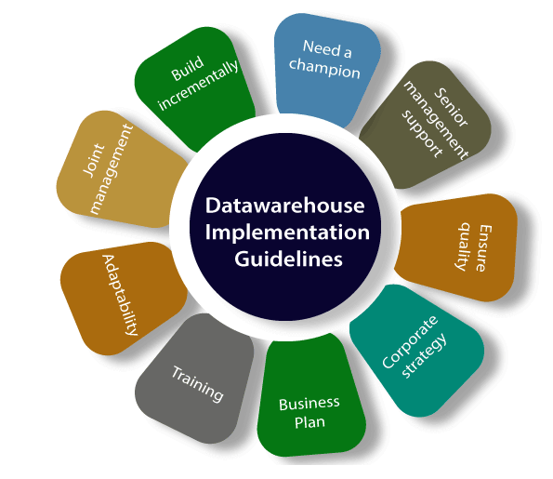
Implementation Guidelines

Slide 90
Implementation Guidelines
Build incrementally: it is recommended that a data marts may be created with one particular project in mind, and once it is implemented, several other sections of the enterprise may also want to implement similar systems
Need a champion: A data warehouses project must have a champion who is active to carry out considerable researches into expected price and benefit of the project.
Senior management support: A data warehouses project must be fully supported by senior management.

Slide 91
Implementation Guidelines
Ensure quality: The only record that has been cleaned and is of a quality that is implicit by the organizations should be loaded in the data warehouses.
Corporate strategy: A data warehouse project must be suitable for corporate strategies and business goals.
Business plan: The financial costs (hardware, software, and peopleware), expected advantage, and a project plan for a data warehouses project must be clearly outlined and understood by all stakeholders.

Slide 92
Implementation Guidelines
Training: A data warehouses project to be successful, the customers must be trained to use the warehouses and to understand its capabilities.
Adaptability: The project should build in flexibility so that changes may be made to the data warehouses if and when required
Joint management: The project must be handled by both IT and business professionals in the enterprise.

Slide 93
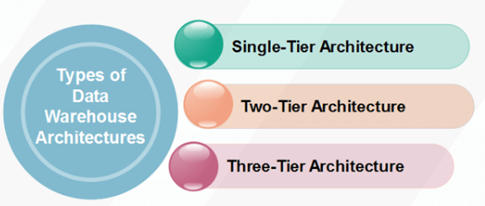
Types of Data Warehouse Architectures

Slide 94
Data Warehouse Architectures: Conceptual View
Operational
systems
Informational
systems
Single-layer
Every data element is stored once only
Virtual warehouse
Two-layer
Real-time + derived data
Most commonly used approach in
industry today
“Real-time data”
Operational
systems
Informational
systems
Derived Data
Real-time data

Slide 95
Three-layer Architecture: Conceptual View
Transformation of real-time data to derived data really requires two steps
Operational
systems
Informational
systems
View level
“Particular informational
needs”
Derived Data
Reconciled Data
Physical Implementation
of the Data Warehouse
Real-time data

Slide 96
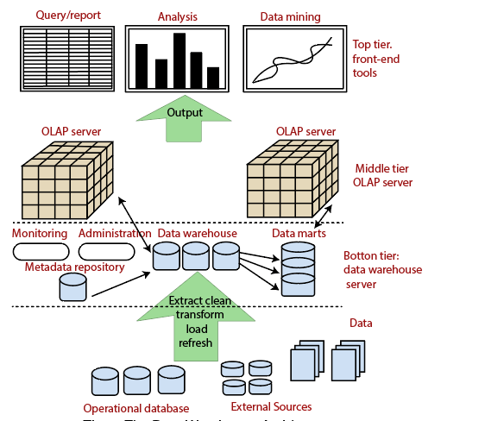
The Three-Tier Architecture of a Data Warehouse

Slide 97
The Three-Tier Architecture of a Data Warehouse
Bottom Tier (Data Warehouse Server)
Middle Tier (OLAP Server)
Top Tier (Front end Tools).

Slide 98
Three-Tier Architecture
Bottom Tier: The bottom tier of the architecture represents the data warehouse database server, also known as the relational database system.
Back-end tools and utilities are made use of to feed data into the bottom tier. These back-end tools and utilities perform the Extract, Clean, Load, and refresh functions.

Slide 99
Three-Tier Architecture
Middle Tier: The middle tier of a data warehouse lies the OLAP Server which is an extended relational database management system.
The ROLAP maps the operations on multidimensional data to standard relational OLAP (MOLAP) model, which directly implements the multidimensional data and operations.
Top-Tier: This tier represents the front-end client layer. This layer holds the query tools and reporting tools, analysis tools and data mining tools.

Slide 100
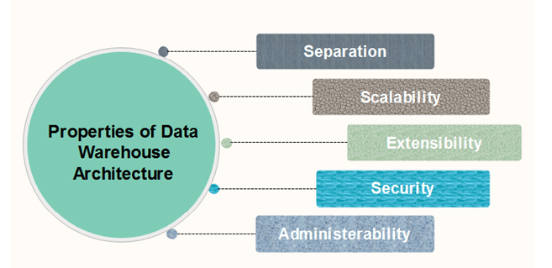
Properties of Data Warehouse Architectures

Slide 101
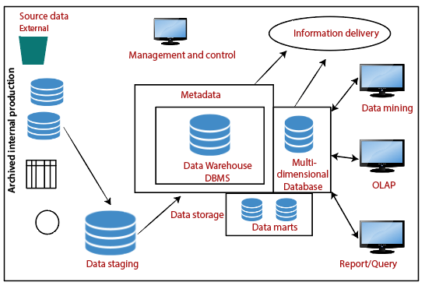
Components of Data Warehouse

Slide 102
Components of Data Warehouse
There are 7 components in Data Warehouse:
Data Warehouse Database
Sourcing, Acquisition, Clean-up and Transformation Tools (ETL)
Metadata
Access Tools
Data Marts
Data Warehouse Administration and Management
Information Delivery System

Slide 103
Meta Data
Metadata is simply defined as data about data.
The data that is used to represent other data is known as metadata.
Metadata can also define as follows.
Metadata is the road-map to a data warehouse.
Metadata in a data warehouse defines the warehouse objects.
Metadata acts as a directory.

Slide 104
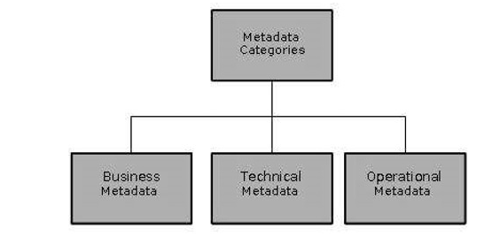
Categories of Metadata
Metadata can be broadly categorized into three categories
Business Metadata
Technical Metadata
Operational Metadata

Slide 105
Business Metadata − It has the data ownership information, business definition, and changing policies.
Technical Metadata − It includes database system names, table and column names and sizes, data types and allowed values.
Technical metadata also includes structural information such as primary and foreign key attributes and indices.
Operational Metadata − It includes currency of data and data lineage.
Currency of data means whether the data is active, archived, or purged.
Lineage of data means the history of data migrated and transformation applied on it.

Slide 106
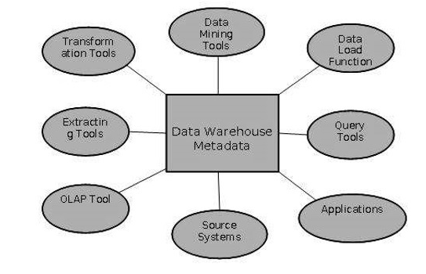
Role of Metadata

Slide 107
Metadata acts as a directory.
Metadata helps in decision support system for mapping of data
Metadata helps in summarization between current detailed data and highly summarized data.
Metadata is used for query tools.
Metadata is used in extraction and cleansing tools.
Metadata is used in reporting tools.
Metadata is used in transformation tools.
Metadata plays an important role in loading functions.

Slide 108
Metadata Repository
Metadata repository is an integral part of a data warehouse system.
It has the followin :
Definition of data warehouse
Business metadata
Operational Metadata
Data for mapping from operational environment to data warehouse
Algorithms for summarization

Slide 109
Definition of data warehouse − It includes the description of structure of data warehouse.
Business metadata − It contains has the data ownership information, business definition, and changing policies.
Operational Metadata − It includes currency of data and data lineage.
Data for mapping from operational environment to data warehouse − It includes the source databases and their contents, data extraction, data partition cleaning, transformation rules, data refresh and purging rules.
Algorithms for summarization − It includes dimension algorithms, data on granularity, aggregation, summarizing, etc

Slide 110

Metadata Interchange Standard Framework

Slide 111
Components of Metadata Interchange Standard Frameworks
Standard Metadata Model: It refers to the ASCII file format, which is used to represent metadata that is being exchanged.
The standard access framework that describes the minimum number of API functions.
Tool profile, which is provided by each tool vendor.
The user configuration is a file explaining the legal interchange paths for metadata in the user's environment.

Slide 112
Important Questions
Data Warehouse data model
Architecture and components
Meta data
Granularity

Slide 113
References
.https://www.javatpoint.com/data-warehouse-components
PPT of text books

